Slide 1
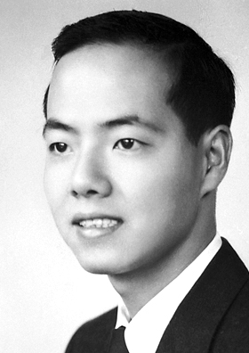
Tsung-Dao Lee
Notes:
# Name Tsung-Dao Lee # Textbook Knight, Physics for Scientists and Engineers: A Strategic Approach with Modern Physics, 3rd Edition, Chapter 42, Section 2 # Textbook # Textbook # Contributors Khai Nguyen # Description Tsung-Dao Lee is a Chinese-American physicist, known for his work on parity violation, the Lee Model, particle physics, relativistic heavy ion physics, nontopological solitons and soliton stars. He was a recipient of the 1957 Nobel Prize in Physics at the age of 30. Lee conducted the majority of his life's research at Columbia University, where his first work was on a solvable model of quantum field theory known as the Lee Model. Later, he worked on the puzzle of K meson decay, through which he studied parity non-conservation in weak interactions. This work led to his winning the Nobel Prize in Physics. He was also very active in statistical mechanics, astrophysics, and a number of other disciplines. # Sources Lee, T. D., & Yang, C. N. (1956). Question of parity conservation in weak interactions. Physical Review, 104(1), 254. Lee, T. D. (1981). Particle Physics and Introduction to Field Theory, Comtemporary Concepts in Physics Vol. 1. Harwood academic publishers. Lee, T. D., & Yang, C. N. (1952). Statistical theory of equations of state and phase transitions. II. Lattice gas and Ising model. Physical Review, 87(3), 410. Yang, C. N., & Lee, T. D. (1952). Statistical theory of equations of state and phase transitions. I. Theory of condensation. Physical Review, 87(3), 404. # Photo https://upload.wikimedia.org/wikipedia/commons/5/53/TD_Lee.jpg

